Slide 1
MINOR PROJECT / 2026
MUNIM
Context-Aware WhatsApp Shopping Assistant
Conversational commerce across WhatsApp and the web — a software engineering prototype for one shopping system behind two front doors.
SAUMYA AGGARWAL 08914812723
SAMAKSH AZARE 05214812723
Maharaja Agrasen Institute of Technology · Computer Science and Technology
01
Notes:
Munim: a WhatsApp shopping assistant with a web storefront that shares one cart, one account and one order history.

Slide 2
01 | NEED
Shopping starts in conversation
01 / CUSTOMER INTENT
02 / SEARCH FRICTION
03 / BROKEN CONTINUITY
“Something for my sister's mehendi, nothing too heavy.”
“Show me something cheaper.”
“I already told you my size.”
SYSTEM GAP
SYSTEM GAP
SYSTEM GAP
Occasion, relationship and budget arrive as meaning, not as form fields.
Keyword search cannot interpret occasion, relationship or preference.
Chat and web hold separate carts, accounts and history.
ENGINEERING QUESTION
How can semantic retrieval and identity linking turn WhatsApp into a reliable front door to one shopping system?
02
Notes:
Three stages of the same failure: meaning is lost, then context is lost.

Slide 3
02 | OVERVIEW
Two front doors, one shopping system
Indian ethnic wear discovery combines retrieval-augmented product search with one shared customer state.
01 / ASK
02 / RETRIEVE
03 / RECOMMEND
04 / CONTINUE
WhatsApp
ChromaDB
WhatsApp
Web storefront
CORE CAPABILITY
CORE CAPABILITY
CORE CAPABILITY
CORE CAPABILITY
Natural-language request in the customer's own words
Retrieval-augmented product discovery over the catalogue
Context-aware matching, presented as numbered choices
Shared identity, cart and order state through checkout
A conversation can begin in WhatsApp and finish in the same shopping system — same cart, same account, same order history.
03
Notes:
The four roles map to the four stages of one purchase.

Slide 4
03 | CONTEXT
Why this problem is hard
Customers live in WhatsApp. Catalogues live on websites. Bridging them is not a UI problem.
01
02
03
Meaning, not keywords
A phone number is the whole identity
Money leaves no room to improvise
“Something for my sister's mehendi, nothing too heavy, under 3000” is not a SQL query.
Meta's webhook sends a number and a message. No cookie, no login, no session.
An LLM that invents a price is worse than no bot. Facts are rendered by code.
84-PRODUCT CATALOGUE
WHATSAPP CLOUD API
WEB STOREFRONT + SHARED CART
RAZORPAY (TEST MODE)
04
Notes:
These three constraints decide the whole design: retrieval, identity, and code-rendered facts.

Slide 5
04 | APPROACH
From customer intent to transaction
Five controlled stages connect catalogue knowledge, conversation context, identity and payment state.
01
02
03
04
05
Catalogue modelling
Semantic indexing
Conversation control
Identity bridge
Transactional flow
→
→
→
→
Title, category, fabric, colour, occasion, fit, sizes, price — 32 fields per product.
all-MiniLM-L6-v2 embeddings with metadata in ChromaDB, 384 dimensions.
Numbered choices, session context, and commands validated in code.
Signed-in web account mints a single-use, time-limited link token sent over WhatsApp.
PostgreSQL state with idempotent, row-locked payment confirmation.
CONTROL PRINCIPLE Product facts, identity binding and transaction confirmation are persisted as explicit system state — never inferred by the model.
05
Notes:
Each stage is a place where meaning is converted into state we can check.

Slide 6
05 | ENGINEERING
Technology stack
01 / CLIENT CHANNELS
Two front doors for one shopping experience.
WhatsApp Cloud API · Jinja2 storefront · Tailwind CSS (compiled)
02 / APPLICATION
Typed logic for webhook, storefront, identity and payment services.
Python · FastAPI + Uvicorn · Pydantic / SQLModel
03 / AI + RETRIEVAL
Local embeddings keep the demo offline and free; the model never states a fact.
all-MiniLM-L6-v2 · ChromaDB · Groq gpt-oss-20b (tool calling)
04 / DATA + PAYMENTS
PostgreSQL protects identity and money; Compose makes the setup repeatable.
PostgreSQL 15 · Razorpay test mode · Docker Compose
06
Notes:
Groq serves the assistant with fallback models; if it is unavailable a plain retrieval path still answers.

Slide 7
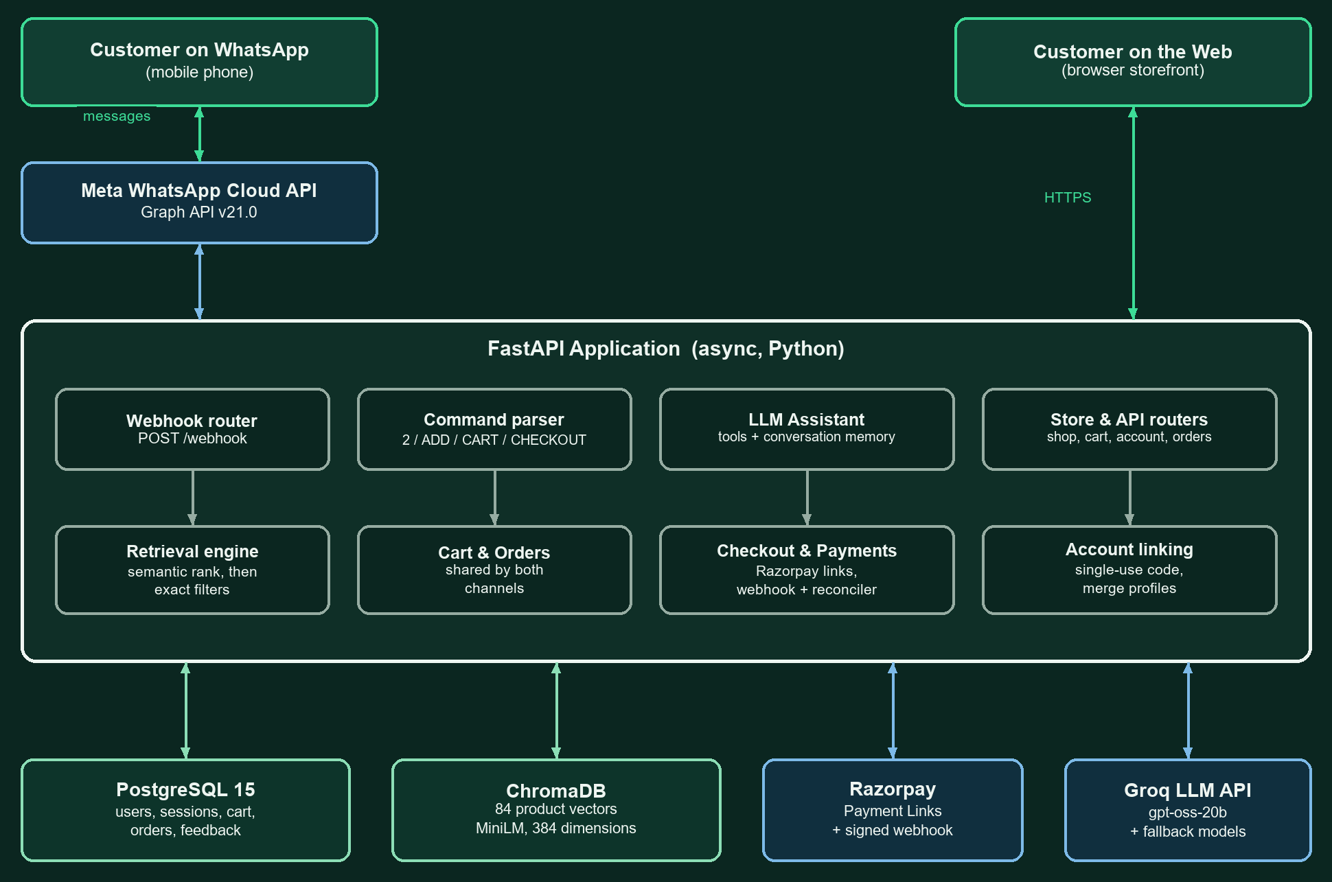
06 | DESIGN
System architecture
07
Notes:
Every arrow that leaves the application is an external service we cannot trust blindly: Meta, Razorpay, the LLM.

Slide 8
07 | IMPLEMENTATION
Prototype status
A working Phase 1 prototype runs end to end — tested on a real phone, including a test-mode payment.
01 CONVERSATION
02 ACCOUNT CONTINUITY
03 COMMERCE
Natural-language request → ChromaDB retrieval → numbered photo cards → contextual “2” or BUY.
Web sign-in → single-use LINK token → sent over WhatsApp → phone bound, earlier history merged.
Shared cart and order schema → Razorpay payment link → signature check → idempotent capture.
RESULT
RESULT
RESULT
Products are discovered and selected in chat.
Identity continues across chat and web.
Exactly one WhatsApp confirmation per payment.
08
Notes:
Three paths, each ending in a checkable result.

Slide 9
08 | PROTOTYPE
How the flow works
01
02
03
04
Natural-language discovery
Numbered product selection
Shared cart state
Payment confirmation
The customer asks for an occasion and a style in their own phrasing.
Photos, details and prices arrive as numbered, selectable cards.
Items added in chat appear in the open web session within seconds.
Razorpay test checkout verifies the payment and a receipt returns to chat.
Semantic retrieval
Session-aware selection
Linked identity and cart
Verified order
09
Notes:
Walk the panel along this line while the live demo is loading.

Slide 10
09 | PROTOTYPE
Prototype in action
End-to-end conversational shopping, demonstrated live
01
02
Discovery & recommendation
Cart, checkout & confirmation
“I need a sherwani for my wedding under 10000”
Three matching products as photo cards with prices
“the second one” — resolved from session context
ADD with a size, CART, CHECKOUT in chat
Razorpay payment link as a Pay Now button
Receipt in WhatsApp; the website updates in place
Working Phase 1 prototype: conversational discovery, shared cart state and test-mode checkout.
10
Notes:
Fallback if the live demo fails: screen recording on the laptop, second tab.

Slide 11
10 | VERIFICATION
What is working — and what comes next
46 / 46
55
18
28
retrieval phrasings pass
assistant checks
account-linking checks
training checks
CURRENTLY WORKING
NEXT SCOPE
Natural-language discovery with photo cards and numbered selection
Account linking; shared cart and orders across both channels
Razorpay test payments, signature check, WhatsApp confirmation
Owner training: the owner approves or rejects a product; ratings re-rank it
Production WhatsApp number and Razorpay credentials
Inventory reservation and fulfilment tracking
Schema migrations for production-ready evolution
Multi-store deployment beyond a single catalogue
Phase 1 demonstrates the integrated path; the next phase hardens inventory, fulfilment and deployment.
11
Notes:
Lead with the numbers: every claim on this deck has a test behind it.

